Slide 1
Lecture no. 9

Slide 2
Urban Land Use Theories

Slide 3
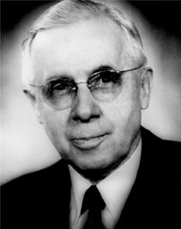
1. Concentric Zone Model
Concentric zone Model is created by the sociologist Ernest Burgess in 1925.
Concentric Zone Model is also known as Burgess Model or CCD model, is one of the earliest theoretical models to explain urban social structures.
Its concept was that cities grow outwards from the Centre in a series of rings.

Slide 4
1. Concentric Zone Model

Slide 5
1. Concentric Zone Model
There are Five Concentric Zones in concentric zone model
1. Central Business District
2. Transition and Industry
Low Incomes
Oldest housing
Ghettos
Zone of independent worker’s home
Low Income Residential
Zone of better residences
Middle Income Residential
Suburban estates-good quality, gardens
5. Commuter’s Zone
High Income Residential Zone
Small Towns and villages

Slide 6
1. Concentric Zone Model
Assumptions
Older buildings in city center.
Newer Buildings at edge of city.
Land values highest in city Centre.
Strong economic and ethnic segregation.
Low income groups lack transport and live close to city Centre.
Cities develop on a flat plain with equal access to transport.

Slide 7
1. Concentric Zone Model
Criticism
Doesn’t consider car ownership.
Landscape not considered.
Impact that industry and transport could have on land use not considered.
zones are never as clear-cut.

Slide 8
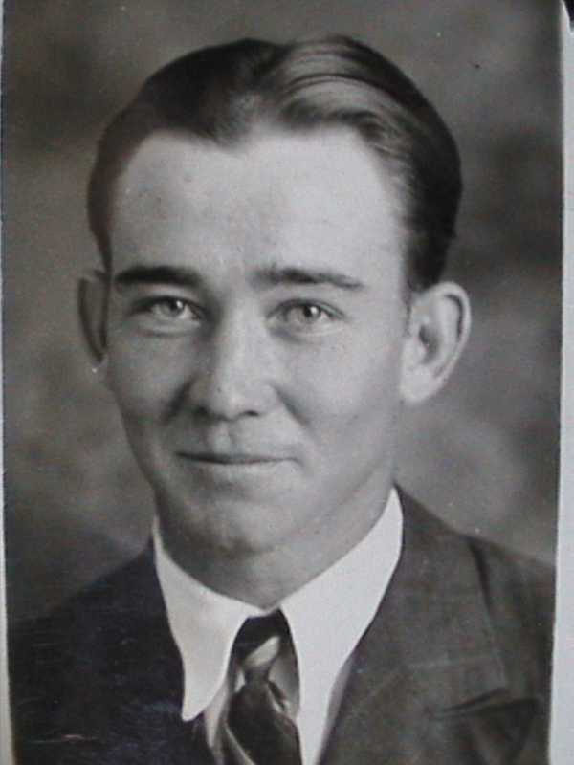
2. Hoyt’s Sector Model
The sector Model is an urban model which succeeded and modified the concentric zone model. It was developed in 1939 by Land economist Homer Hoyt.
Sectors radiating out from the CBD along transport routes.

Slide 9
2. Hoyt’s Sector Model

Slide 10
2. Hoyt’s Sector Model
Assumptions
Settlements develops along transport routes.
Towns radiate out from CBD.
Low income and industrial area lie next to each other.
Wealthy people choose the best sites.
Criticism
Too general
In reality, most zones contain more than one land-use.

Slide 11
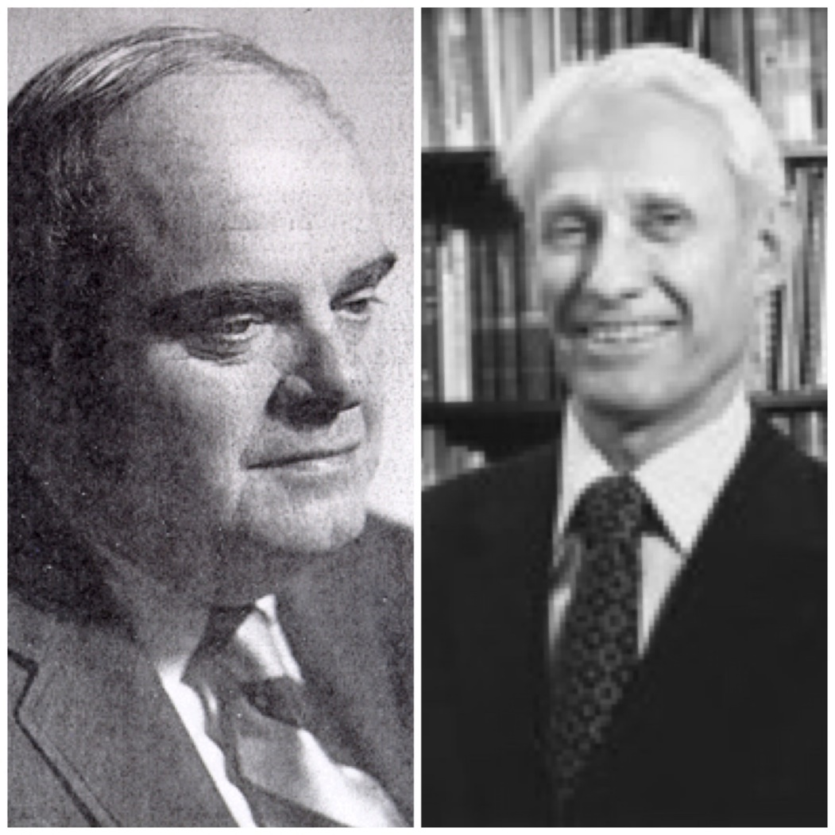
3. Multiple Nuclei Model
The Multiple Nuclei Model is an ecological model created by Chauncy Harris and Edward Ullman in the 1945. This model was aimed at being more specific than the other two models; however, it also has become more complicated.
As an urban area grows, it develops around a number of different business Centres or nuclei.

Slide 12
3. Multiple Nuclei Model

Slide 13
3. Multiple Nuclei Model
Assumptions
Modern cities more complex than suggested by other theorists.
Each nucleus act as a growth point.
Growth occurs outwards from each nucleus, until they all merge into one large urban area.
Mixture of Burgess and Hoyt.
Shows some land uses attract more of the same, for example industrial area.
Some land uses may deter others from locating nearby, e.g., housing is usually located away from industrial area.

Slide 14
3. Multiple Nuclei Model
Criticism
Not an exact fit for all cities and towns.
Too complex

Slide 15
Common Features of the Three Models
Focus on importance of accessibility; CBD is the most accessible and its land value is the highest.
Land values & Population density decline with distance from the Centre.
Clear-cut and abrupt boundaries between the Land-use zones.
Concern the study of ground-floor functions; height of buildings is neglected.
Residential segregation

Slide 16
Difference among three Models
Concentric and Sector Model are mono-centric while Multiple Nuclei Model is polycentric.
Multiple nuclei model is more complex in terms of land use zones, e.g. industrial suburbs.
Multiple nuclei Model allows suburbanization, transport development, outward growth of city.

